Slide 1

Artificial Intelligence BAI402
Balaji Vijaykumar B.E.,(NIE), M.Tech.,(SJCE)
Assistant Professor, Department of CS&E-AIML
The National Institute of Engineering, Mysuru
(Former Research & Development Engineer @ Philips R&D)
(Former Software Engineer @ Accenture)

Slide 2

INTELLIGENT AGENTS
In the world of artificial intelligence, An agent is something that acts autonomously to achieve its goals.
A rational agent, in particular, is one that makes decisions to achieve the best outcome or, when faced with uncertainty, the best expected outcome.
Intelligent agents are autonomous entities that perceive their environment through sensors and act upon it using actuators.
Agent:Automatic door opener: It detects the presence of a person (perception) and opens the door (actuation) to allow entry.
Rational Agent:
Recommendation System (e.g., Netflix): Learns your viewing history and trends (perception) and suggests movies and shows you’re likely to enjoy (actuation). It doesn’t know your exact mood but uses data to maximize the chance of you hitting "Play."
Intelligent Agent:
Self-driving car: It perceives its surroundings using sensors such as cameras and LiDAR (perception) and makes decisions about speed, steering, and braking (actuation) to navigate safely to its destination.

Slide 3
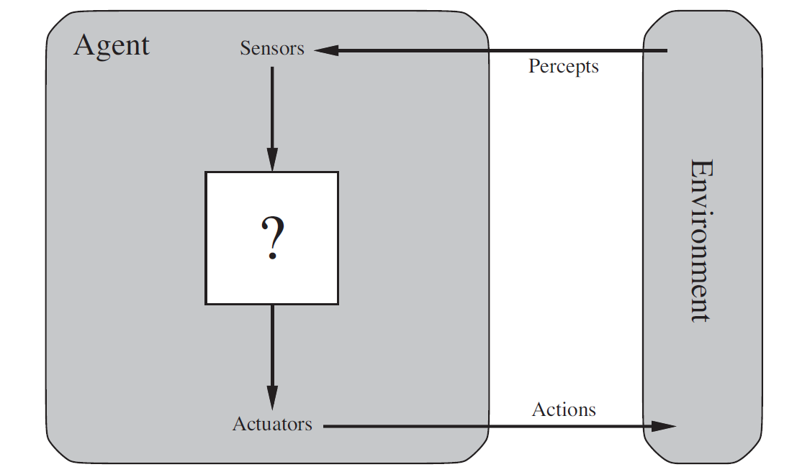
Agents and Environments
Agents perceive their environment through sensors and act upon it using actuators.
Human agents have sensory organs like eyes and ears, allowing them to perceive the environment, while their hands, legs, and vocal tract serve as actuators to interact with the world. For instance, if a person sees a doorbell (perception), they might use their hand to press it (action).
Software agents like ChatGPT or virtual assistants like Siri receive inputs through text or voice commands. They act by providing relevant responses, setting reminders, answering questions, or performing tasks like sending messages—all autonomously and based on the user's needs.

Slide 4
Percept and Percept Sequence
Percept:
A percept refers to the sensory input received by an agent at any specific moment in time.
It represents the agent's immediate observation of its environment.
For example, if we consider a robot vacuum cleaner, a percept could be the current location and the status of cleanliness (e.g., whether the square it's in is dirty or clean) at a particular instant.
Percept Sequence:
A percept sequence is the complete history or series of percepts that the agent has experienced over time.
Using the same example of the robot vacuum cleaner, a percept sequence would be the entire record of the locations it has visited and the corresponding cleanliness status of each square from the start of its cleaning operation up to the present moment.

Slide 5
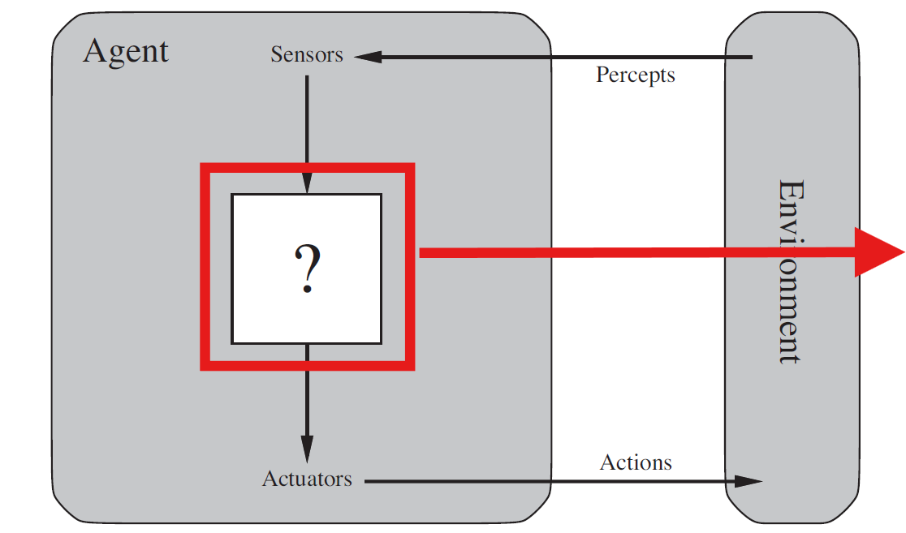
Agent Function and Agent Program
Agent Function: An agent function is an abstract description that maps percepts (inputs) to actions (outputs). It defines the behavior of the agent based on its observations of the environment.
Agent Program: An agent program is the concrete implementation of the agent function, running within a physical system.

Slide 6
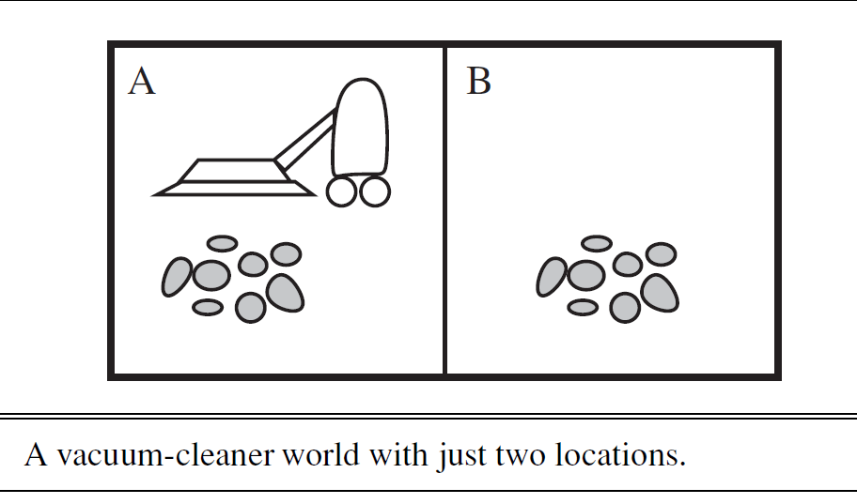
Agents and Environments-A vacuum-cleaner world
Vacuum-Cleaner World Example:
Simple world with two locations (squares A and B) and dirt.
Vacuum cleaner agent perceives its location and dirt presence, chooses actions accordingly.
Example Agent Function: If square is dirty, suck; else, move to the other square;
Agent Program implements this function.

Slide 7
Agents and Environments-A vacuum-cleaner world
function REFLEX-VACUUM-AGENT([location, status]) returns an action
if status = Dirty then
return Suck
else if location = A then
return Right
else
return Left
This function represents the abstract description of the agent's behavior, mapping percepts (location and status) to actions, making it an agent function.
Given the initial situation where both squares A and B are dirty and the vacuum cleaner is initially located at square A

Slide 8
Agents and Environments- The simple reflex agent
Initial State: The agent perceives [A, Clean].
Action: The agent moves Right to square B.
Percept Sequence: [B, Clean]
Action: According to the agent function, since B is clean, it should move Left to square A.
Percept Sequence: [A, Clean]
Action: As per the agent function, since A is clean, it should move Right to square B.
The agent gets caught in a loop, continually moving back and forth between squares A and B since both are clean.
function REFLEX-VACUUM-AGENT([location, status]) returns an action
if status = Dirty then
return Suck
else if location = A then
return Right
else
return Left
Limitation: The simple reflex agent lacks memory of its previous actions or the state of the environment beyond the current percept. Therefore, it gets stuck in a loop when both squares are clean, inefficiently moving left and right without achieving any meaningful outcome.

Slide 9
Good Behavior: The Concept of Rationality
In the realm of artificial intelligence, a rational agent is one that consistently makes the best possible decisions based on its understanding of the environment.
But what does it mean to make the right decision?

Slide 10
Good Behavior: The Concept of Rationality
Consequences Matter:
A rational agent's behavior is evaluated based on the consequences of its actions in the environment.
As the agent interacts with its surroundings, it triggers a sequence of actions that leads to a series of environment states.
If this sequence of states aligns with what is considered desirable, the agent is deemed to have performed well.
Example:
Imagine you have a robot vacuum cleaner. Its job is to keep your house clean.
If the robot moves around and cleans up all the dirt, leaving your floors spotless, that's good behavior.
But if it just pushes dirt around or ignores some areas, that's not so great.

Slide 11
Good Behavior: The Concept of Rationality
Performance Measure:
A Performance Measure is used to evaluate how well an agent is achieving its goal.
What is Being Measured?
The desirability of outcomes based on the sequence of environment states created by the agent's actions.
It checks the actual impact of the agent’s behavior, not just what the agent believes it is doing.
Why is This Important?
The agent cannot judge its own success just by its internal perception.
It prevents an agent from deceiving itself into thinking it is doing well when it is actually failing.
Example:
Self-Driving Car
The car might "think" it is following traffic rules, but if it causes an accident, the performance measure will reflect poor driving.
Spam Filter
If a spam filter blocks important emails, it believes it is working well, but in reality, it is failing because the user is missing important messages.

Slide 12
Good Behavior: The Concept of Rationality
Designing Performance Measures:
Creating a good performance measure is both crucial and challenging because it must align with the actual goals of the agent in its environment. A poorly designed measure can lead to unintended behavior, where the agent tries to "game the system" instead of truly optimizing for the best outcome.
Key Considerations:
Alignment with Goals – The measure should reflect the desired long-term success. Avoiding Exploitation – The agent shouldn’t be able to cheat the system to maximize its score unfairly. Balancing Factors – Multiple aspects like efficiency, resource usage, and unintended side effects should be considered.
Example:
A Cleaning Robot
🔹 Suppose we reward the robot only based on the amount of dirt it picks up. 🔹 The robot might find a loophole—picking up dirt and dropping it again just to increase its score! 🔹 A better measure would reward the robot for keeping the floor clean over time, while also considering factors like:
Energy Efficiency – Avoid unnecessary movement to save battery.
Noise Control – Don’t disturb people while cleaning.
A well-thought-out performance measure ensures that the agent behaves in a truly rational and beneficial manner rather than just maximizing a flawed score.

Slide 13
Good Behavior: The Concept of Rationality
Complex Considerations:
Even with well-thought-out performance measures, designing an ideal system is not straightforward. Several challenges arise:
What does a clean floor actually mean?
Should it be completely spotless all the time?
Or should we measure the average cleanliness over a period?
Two robots may achieve the same cleanliness score but in different ways:
One cleans constantly but wastes energy.
Another cleans less often but still maintains acceptable cleanliness.
Example:
Imagine two cleaning robots: 🔹 Robot A: Cleans every 5 minutes, using lots of energy but keeping the floor spotless. 🔹 Robot B: Cleans once an hour but still prevents visible dirt buildup.
Both may achieve the same cleanliness score, but one is more energy-efficient. Which one is truly better?

Slide 14
Good Behavior: The Concept of Rationality
Conclusion:
Designing performance measures for AI systems, such as cleaning robots, goes beyond simple rules. While we can set clear goals—like keeping the floor clean—defining how success is measured introduces complexity.
An ideal AI system must balance multiple factors, including: ✔ Effectiveness – Does it achieve the goal (e.g., a clean floor)? ✔ Efficiency – Does it use resources wisely (e.g., energy consumption)? ✔ Adaptability – Can it adjust to different situations and user needs?
The key takeaway? AI decision-making isn’t just about achieving the best score—it’s about making smart trade-offs that align with real-world needs. By refining performance measures, we ensure AI systems act not just intelligently, but also rationally and efficiently.

Slide 15
Rationality
Understanding Rationality:
In the realm of artificial intelligence, rationality refers to the ability of an agent to make decisions that are expected to achieve its goals or objectives effectively. Essentially, it's about doing the right thing given the available information and resources.
Rationality in artificial intelligence depends on four key factors:
Performance Measure: This defines the criterion of success for the agent.
Prior Knowledge: The agent's understanding of the environment before taking any action.
Available Actions: The actions that the agent can perform in its environment.
Percept Sequence: The agent's history of sensory inputs up to the present moment.

Slide 16
Applying the concept of rationality to the vacuum cleaner agent
Performance Measure:
In the case of the vacuum cleaner agent, the performance measure could be defined as the total number of clean squares over a certain period of time. For example, the agent earns one point for each clean square at each time step. The objective is to maximize the number of clean squares to achieve a high score.
Prior Knowledge:
Before the vacuum cleaner starts operating, it may have some prior knowledge about the environment. This includes knowing the layout of the space it needs to clean (such as the arrangement of squares A and B), understanding its own capabilities and limitations, and being aware of the actions it can take.

Slide 17
Applying the concept of rationality to the vacuum cleaner agent
Available Actions:
The vacuum cleaner agent has a limited set of actions it can perform: moving left, moving right, or sucking up dirt. These actions are determined by the agent's programming and are based on its understanding of the environment.
Percept Sequence:
As the vacuum cleaner moves around the environment, it continuously perceives its current location and whether that location contains dirt. This sequence of sensory inputs forms the percept sequence, which informs the agent's decision-making process.

Slide 18
Rationality and Adaptability
Rationality of the Vacuum Cleaner Agent:
Under these circumstances, the vacuum cleaner agent is rational. Its expected performance is as high as or higher than any other agent's in the same environment.
Adaptability of Rationality:
However, the same agent may be irrational under different conditions. For instance, if all dirt is cleaned, the agent may oscillate needlessly, resulting in poor performance. In such cases, a better agent would adjust its actions based on the current environment and performance measure.
For instance, if it perceives that all squares are clean, it may stop moving and remain idle until new dirt appears.

Slide 19
Omniscience, learning, and autonomy
Rationality vs. Omniscience:
Rationality is about making the best decisions based on available information, while omniscience implies knowing all outcomes in advance, which is impossible in reality.
Example: Imagine you're crossing a street when suddenly, a cargo door falls from a passing airplane and hits you. You couldn't predict this event, so crossing the street was rational based on the information you had at the time.
Rationality Doesn't Mean Perfection:
Rationality focuses on maximizing expected performance, not achieving perfect outcomes.
Example: Even if you look both ways before crossing a busy road, there's still a risk of accidents. Rationality involves making the best decision based on the information available, even if the outcome isn't perfect.

Slide 20
Omniscience, learning, and autonomy
Importance of Information Gathering:
Rational agents gather information to make informed decisions and maximize expected performance.
An informed decision is a choice made using all available and relevant information. Instead of guessing or acting randomly, the agent uses the percept sequence (the history of what it has sensed) to decide the best next step.
Example: Before crossing a road, it's rational to look both ways to gather information about oncoming traffic. This action helps minimize the risk of accidents and improves overall performance.
Learning and Adaptation:
Rational agents learn from their experiences and adapt their behavior to improve performance over time.
Example: A vacuum-cleaning robot learns from past cleaning sessions to anticipate where and when dirt is likely to accumulate. By learning, it becomes more efficient in maintaining cleanliness.

Slide 21
Omniscience, learning, and autonomy
Autonomy: A rational agent should strive for autonomy, meaning it can learn and make decisions independently, rather than relying solely on the initial knowledge provided by its designers.
Example: An autonomous vacuum-cleaning robot doesn't rely solely on pre-programmed instructions but learns from its environment to optimize cleaning strategies, such as avoiding obstacles and efficiently covering all areas.
Conclusion:
Understanding the distinctions between rationality, omniscience, learning, and autonomy is crucial in designing intelligent agents. While rationality guides agents to make optimal decisions based on available information,
omniscience is an unattainable ideal of knowing all outcomes in advance. Learning allows agents to adapt and improve their performance over time, while autonomy empowers them to rely less on prior knowledge and more on their own experiences.
By integrating these concepts effectively, we can design intelligent agents capable of navigating diverse environments and achieving desired goals autonomously.

Slide 22
THE NATURE OF ENVIRONMENTS
In AI, we're diving into the world of rational agents, which are essentially problem solvers.
Task environments, which are essentially the “problems” to which rational agents are the “solutions.”
These environments essentially define the problems the agents will solve.
The design of intelligent agents process involves specifying the task environment, which includes identifying the performance measure, the environment itself, and the agent's actuators and sensors.
This description is often abbreviated as PEAS, standing for Performance, Environment, Actuators, and Sensors.

Slide 23
Understanding PEAS Description
PEAS provides a structured way to define intelligent agents by specifying their Performance measures, Environment, Actuators, and Sensors. Let’s analyze it using the example of an automated taxi driver.
Performance (What defines success?)
Definition: Specifies the criteria for evaluating the agent’s success. Example: The performance of an automated taxi driver is measured by:
Reaching the destination safely and efficiently.
Minimizing fuel consumption.
Obeying traffic laws.
Providing passenger comfort.
Maximizing operational efficiency and profitability.

Slide 24
Understanding PEAS Description
Environment (Where does the agent operate?)
Definition: The external factors and surroundings that the agent interacts with. Example: The environment for an automated taxi includes:
Roads, traffic signals, and lane markings.
Other vehicles and pedestrians.
Weather conditions such as rain or fog.
Passengers with different destinations and preferences.
Actuators (How does the agent take action?)
Definition: Actuators are the components that allow the agent to influence and interact with its environment. Example: In an automated taxi, actuators include:
Steering wheel – Controls direction.
Accelerator – Increases speed.
Brakes – Slows down or stops the vehicle.
Turn signals – Communicates lane changes and turns.
Horn and display screens – Used for communication with passengers and other drivers.

Slide 25
Understanding PEAS Description
Sensors (How does the agent perceive the environment?)
Definition: Sensors collect information from the environment, enabling the agent to understand and make informed decisions. Example: The taxi’s sensors include:
Cameras – Detect road signs, traffic lights, and pedestrians.
Radar/Sonar – Measures distance from other vehicles and obstacles.
GPS – Determines location and provides navigation.
Speedometer – Monitors speed to ensure safe driving.
Engine and diagnostic sensors – Track fuel levels, engine health, and other vehicle conditions.
PEAS (Performance, Environment, Actuators, Sensors) is a framework for defining how intelligent agents operate. Performance sets the success criteria, Environment includes everything the agent interacts with, Actuators enable actions, and Sensors collect data for decision-making. For an automated taxi, actuators like steering and brakes control movement, while sensors like cameras and GPS gather real-time information for safe navigation.

Slide 26
Bringing it All Together: Automated Taxi Driver Example
Performance: The taxi aims for safe, fast, and legal trips while maximizing passenger comfort and profits.
Environment: It operates on roads with other vehicles, pedestrians, and potential passengers.
Actuators: The taxi controls its movement using steering, acceleration, braking, and communicates with passengers through displays or voice.
Sensors: It perceives its surroundings through cameras, sonar, GPS, and various vehicle sensors.
By defining the PEAS description, we provide a clear understanding of the agent's objectives, its operating environment, the tools it has to interact with the world, and the information it gathers to make decisions. This framework helps in designing effective and efficient intelligent agents for various tasks and environments.

Slide 27
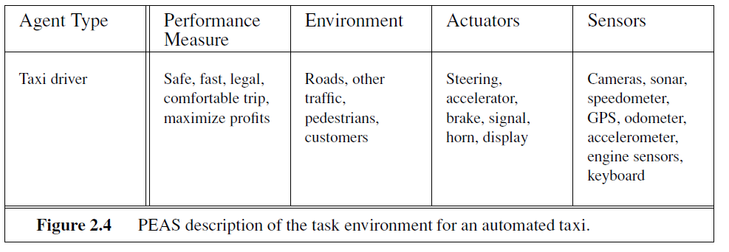
Bringing it All Together: Automated Taxi Driver Example

Slide 28
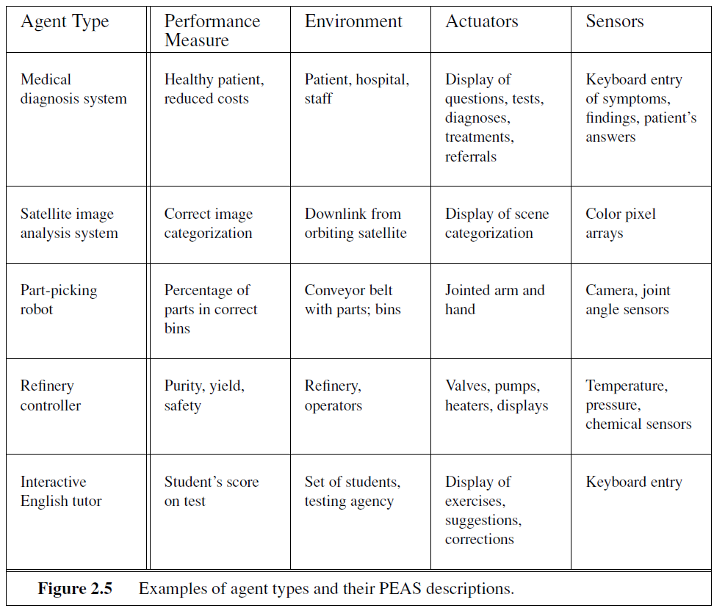
Examples of agent types and their PEAS descriptions

Slide 29
Properties of Task Environments
Dimensions of Task Environments:
Fully vs. Partially Observable: Can the agent observe the complete state of the environment?
Single Agent vs. Multiagent: Is the agent operating alone or alongside other agents?
Deterministic vs. Stochastic: Is the outcome of actions predictable or subject to randomness?
Episodic vs. Sequential: Are decisions made independently in discrete episodes or sequentially?
Static vs. Dynamic: Does the environment change while the agent is making decisions?
Discrete vs. Continuous: Are the state, time, and actions discrete or continuous?
Known vs. Unknown: Is the environment fully understood or uncertain to the agent?

Slide 30
Understanding Properties of Task Environments
Fully Observable vs. Partially Observable: Think of this as whether the agent can see everything or only part of the environment. In a fully observable environment, the agent knows everything relevant to its actions, while in a partially observable environment, it might miss some information.
Fully Observable: In a fully observable environment, the agent (the decision-maker) has access to all relevant information necessary for making decisions. It can perceive everything happening in its environment.
Partially Observable: In contrast, a partially observable environment is one in which the agent cannot access or observe all relevant information. Some aspects of the environment may be hidden or obscured from the agent's sensors, leading to uncertainty in decision-making.
Example: The robot vacuum cleaner environment can be considered partially observable. While the robot may have sensors like cameras to perceive its surroundings, there may still be areas in the house that are obstructed or out of view, such as under furniture or behind closed doors.

Slide 31
Understanding Properties of Task Environments
Single Agent vs. Multiagent: This is about whether the agent is the only decision-maker or if there are others
Single Agent: This refers to situations where there is only one decision-making entity involved. The agent operates independently and does not interact with other decision-makers.
Multiagent: In multiagent environments, there are multiple decision-making entities, often interacting with each other. Each agent's actions can influence the environment and the actions of other agents.
Think of a single-player video game versus a multiplayer game.
Example: The robot vacuum environment is primarily single-agent. The robot is the only entity making decisions and taking actions within the environment. However, if we consider other family members or pets moving around the house, it could be seen as a multiagent environment. Still, the robot's primary focus is on its own actions.

Slide 32
Understanding Properties of Task Environments
Deterministic vs. Stochastic: The outcome of every action is predictable with certainty. Deterministic environments have predictable outcomes based on actions, while stochastic ones have some randomness.
Deterministic: In a deterministic environment, the outcome of an action is entirely predictable given the current state of the environment and the action taken by the agent. There is no randomness involved.
Stochastic: Stochastic environments introduce randomness or uncertainty into the outcomes of actions. Even with perfect knowledge of the current state and action, the outcome may vary probabilistically.
Example: Weather prediction AI – Even with the same data, future weather can be unpredictable. Real-World Analogy: Rolling dice in a board game—the result is not guaranteed.

Slide 33
Understanding Properties of Task Environments
Episodic vs. Sequential: Episodic tasks involve separate episodes where each decision doesn't affect future ones, while sequential tasks have actions that affect future decisions.
Episode: Episodic: An episodic environment consists of distinct episodes or tasks that are independent of each other. The outcome of one episode does not affect subsequent episodes.(Percept)
Sequential: In a sequential environment, actions taken by the agent in one time step can influence future actions and outcomes. There is a sequential dependency between actions and their consequences over time. (Percept Sequence)
The vacuum cleaner's actions are sequential because what it does in Room A can impact what it does in Room B. For instance, if the vacuum cleaner starts cleaning Room A and encounters a large amount of dirt, it may spend more time there, affecting its ability to clean Room B within a certain timeframe.
Each cleaning action by the vacuum cleaner in one square can be considered as an episode.

Slide 34
Understanding Properties of Task Environments
Static vs. Dynamic: Static environments remain unchanged while the agent decides, while dynamic ones keep changing.
Static: In a static environment, things stay the same while the agent is making decisions. It's like solving a puzzle where the pieces don't move until you decide your next move.
Dynamic: A dynamic environment changes while the agent is deciding. For instance, in real-life scenarios like driving, the road conditions and traffic are always changing, even as you're making decisions about where to go.
The environment is dynamic. While the layout of the house may remain relatively static, the presence of people or pets moving around can change the environment's state while the robot is operating. For instance, a person walking into a room the robot is cleaning could alter its path or require it to temporarily pause its cleaning task.

Slide 35
Understanding Properties of Task Environments
Discrete vs. Continuous: This refers to whether states, actions, and time are discrete or continuous.
Discrete: The state of the squares (clean or dirty) and the actions of the vacuum cleaner (move left, move right, suck) can be considered discrete. The vacuum cleaner operates in distinct steps without continuous variation.
Continuous: If the dirt accumulation rate or the movement of the vacuum cleaner is continuous and can vary smoothly, it introduces continuous elements into the environment.
Example: A robotic arm – It moves smoothly instead of in fixed steps. Real-World Analogy: A stopwatch—it tracks time in milliseconds, not just whole seconds.
The environment is a mix of discrete and continuous aspects. The robot may encounter discrete elements such as furniture or objects to pick up, but its movement and perception of space are continuous. For example, the robot's sensors provide continuous feedback on its position and surroundings, allowing it to navigate smoothly through the house.

Slide 36
Understanding Properties of Task Environments
Known vs. Unknown: Known environments have predictable outcomes, while unknown ones require the agent to learn.
Known: In a known environment, outcomes are predictable because the agent understands the rules and patterns. For example, if you've played a video game many times, you know what to expect because you understand the game's rules.
Unknown: In an unknown environment, outcomes are unpredictable because the agent doesn't fully understand the rules or patterns. For instance, encountering a new video game for the first time means you have to learn as you play because you don't know all the rules yet.
The environment is mostly known. We have a general understanding of the layout of the house and the types of obstacles the robot may encounter. However, there could be unknown elements, such as new obstacles or changes in the environment that the robot hasn't encountered before.

Slide 37
Describe Properties of Task Environments
Agent Type | Performance Measure | Environment | Actuators | Sensors
Robotic Waiter | Efficient service, Accurate order delivery, Customer satisfaction | Restaurant environment with tables, chairs, kitchen, customers | Arms for carrying trays, Wheels for navigation | Cameras for detecting customers and obstacles, Microphones for voice commands
Agent Type | Performance Measure | Environment | Sensors | Actuators
Personal Assistant | Efficient task completion, Accuracy of responses, User satisfaction | Virtual workspace (e.g., computer or smartphone) | Microphone, Camera, Touchscreen, Keyboard | Speaker, Screen display, Haptic feedback

